Slide 1
Sleep Health and Lifestyle Analysis
A Look At Sleep Health Data
Data Scientist: Greg Hein
© 2024 Udacity.

Slide 2
Agenda
Results of sleep health and lifestyle analysis
Data Description
Typical Amount of Physical Activity
Number of Daily Steps
Distribution of Heart Rates

Slide 3
Data Description
The Dataset has many different types of variables.
Sleep Duration is an example of a continuous variable in the dataset.
Physical Activity Level is an example of an integer variable in the dataset.
Quality of Sleep is an example of an ordinal categorical variable in the dataset.
Occupation is an example of a nominal categorical variable in the dataset.

Slide 4
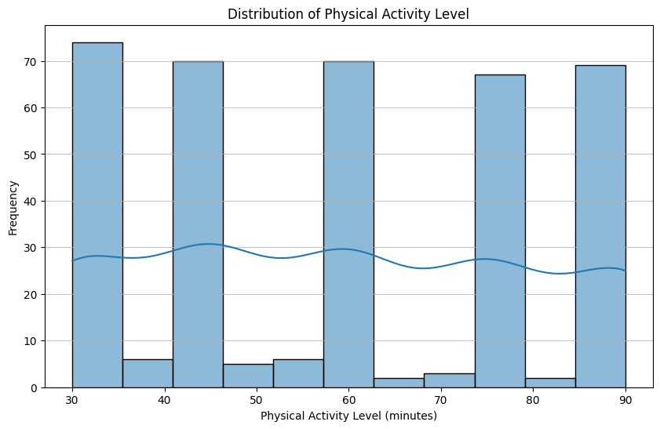
Typical Amount (Minutes) of Physical Activity
Mean Physical Activity Level: 59.17 minutes
Median Physical Activity Level: 60.00 minutes
Mode Physical Activity Level: 60 minutes

Slide 5
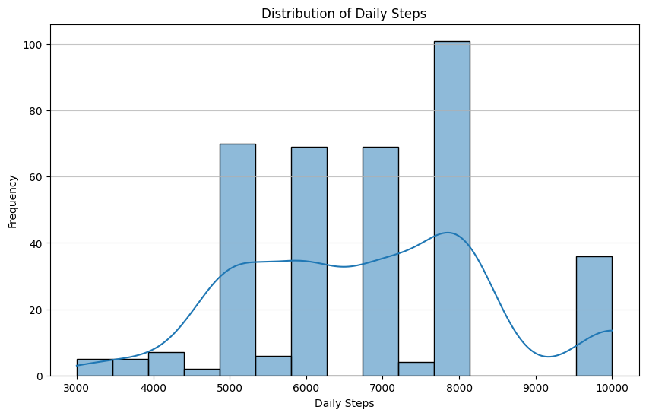
Analysis of Daily Steps Taken
Standard Deviation of Daily Steps: 1617.92
Maximum Daily Steps: 10000
Minimum Daily Steps: 3000
Range of Daily Steps: 7000

Slide 6
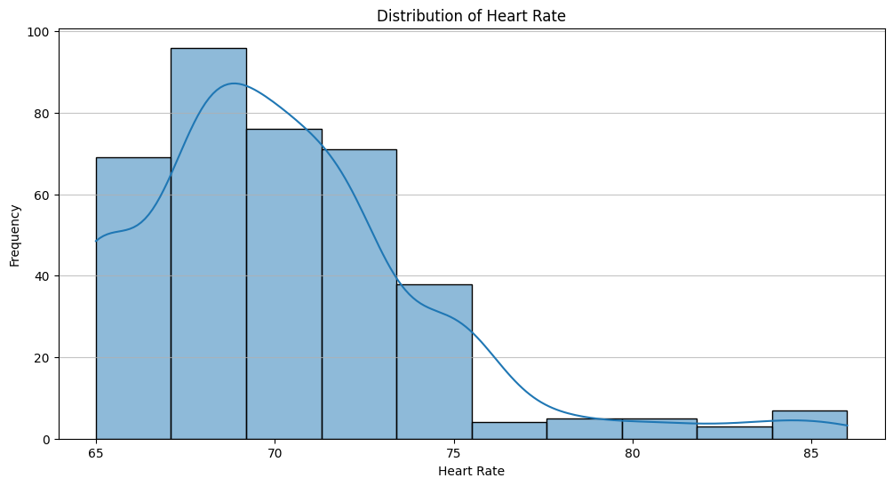
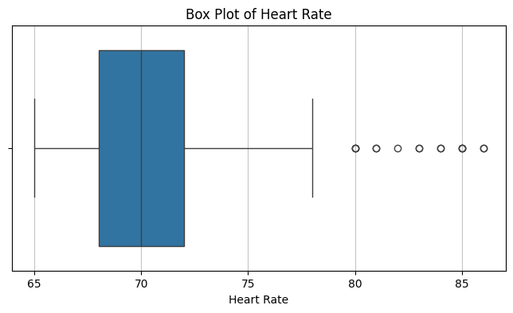
Distribution of Heart Rates
The plots below show the distribution of heart rates and illustrate a significant amount of outliers in the dataset.

